Slide 1

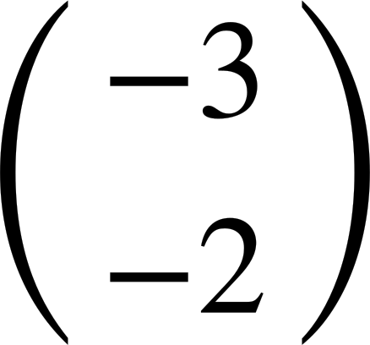

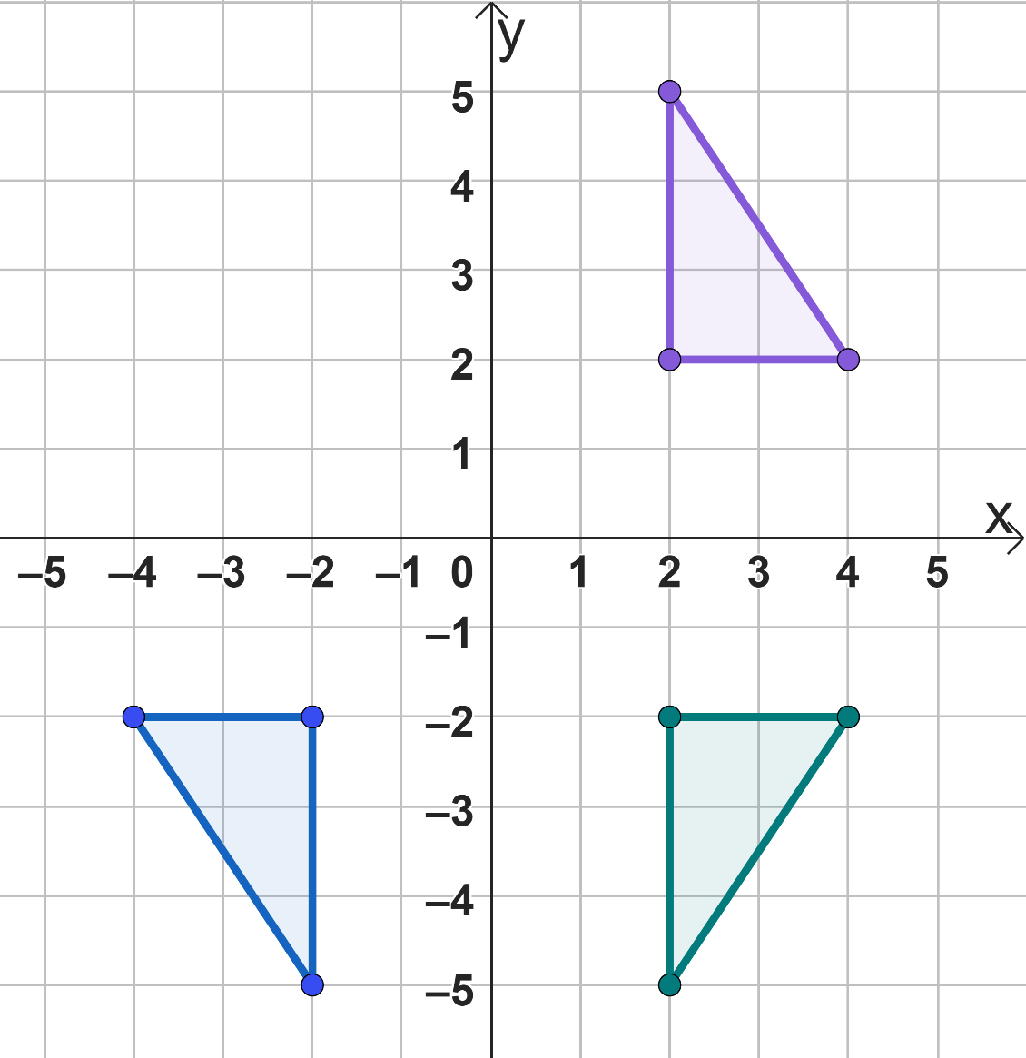
Problem solving with transformations
Task A: Inverse problems
Shape M is translated by to create shape N. What vector would translate shape N onto shape M?
Shape P is reflected in the x-axis to create shape Q. What transformation would map shape Q back on to shape P?
Reflection in the x-axis. (Depending on shape P it could be a translation or rotation as well).
Shape R is enlarged by a scale factor of 4 from the origin. What enlargement scale factor would be needed to map back to shape R?
Shape A is reflected in the x-axis to become shape B. Shape B is then reflected in the y-axis to become shape C.
Fully describe a single transformation that can map shape C onto shape A.
A
Rotate shape C 180° about the origin.
C
B
Task B: Perimeter and area
A shape has a perimeter of 10 cm.
If it is translated its perimeter would be 10 cm.
If it is rotated its perimeter would be 10 cm.
If it is reflected its perimeter would be 10 cm.
If it is enlarged by scale factor 0.5, its perimeter would be 5 cm.

Slide 2
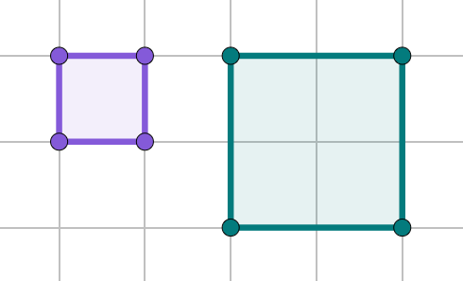
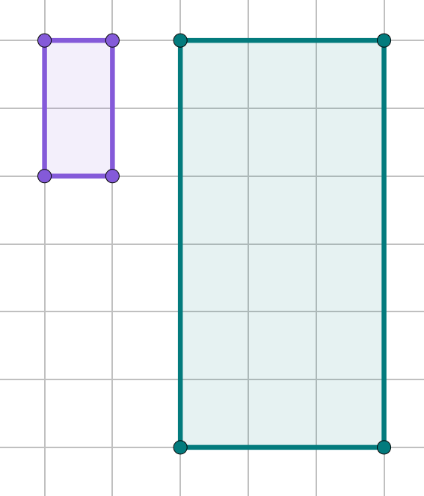
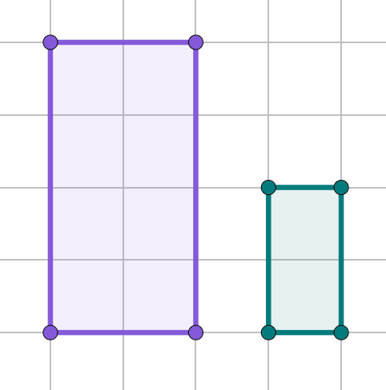
Problem solving with transformations
Task B: Perimeter and area
A shape has a perimeter of 10 cm.
If it is translated its perimeter would be 10 cm.
If it is rotated its perimeter would be 10 cm.
If it is reflected its perimeter would be 10 cm.
If it is enlarged by scale factor 0.5, its perimeter would be 5 cm.
Work out the perimeter and area of the object and image in the following enlargements. Use 1 square = 1 cm.
a)
b)
c)
A
B
A
B
A
B
Perimeter (A)= 4 cm
Area (A) = 1 cm²
Perimeter (B) = 8 cm
Area (B) = 4 cm²
Perimeter (A)= 6 cm
Area (A) = 2 cm²
Perimeter (B) = 18 cm
Area (B) = 18 cm²
Perimeter (A)= 12 cm
Area (A) = 8 cm²
Perimeter (B) = 6 cm
Area (B) = 2 cm²
Mathematics in Education and Industry.

Slide 3
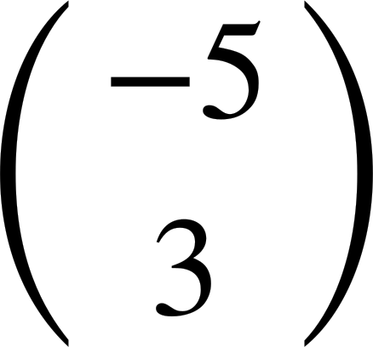







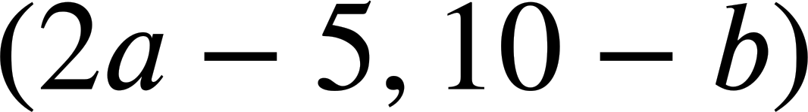




Problem solving with transformations
Task C: Coordinate problems
The following points have been translated by Write the coordinate of the image.
a)
b)
c)
d)
e)
If these are the coordinates for the vertices, what transformation has occurred?
Object: A(1,4) B(1,1) C(2,1) Image: A′(4,4) B′(4,1) C′(5,1)
b
Translated by
b)
Object: A(1,4) B(1,1) C(2,1) Image: A′(1,4) B′(1,7) C′(2,7)
a
Reflected in a horizontal line.
Mathematics in Education and Industry.

